Slide 1

PAPER PROTOTYPING
CHAPTER 09

Slide 2
Topics
Benefits of Paper Prototypes
Paper Prototyping Tools
Example Paper Prototype
Constructing the Prototype
Playtest Questions
Best Uses of Paper Prototyping
Poor Uses of Paper Prototyping

Slide 3
Benefits of Paper Prototypes
  Digital technologies have led to a whole new world of possibilities for game design
  But many designers still use paper prototypes to quickly implement and test new game ideas
  The two main reasons for this are:
Speed & Ease of implementation

Slide 4
Benefits of Paper Prototypes
Initial Development Speed
  It is very fast to get from concept to playable prototype
  Digital games can take days (or at least several hours)
  A simple paper prototype can be playable within 10 minutes
Iteration Speed
  In digital prototyping, changes take time, and the code must be carefully designed to be changeable
  In a paper prototype, it's even possible to change the game in the middle of playing it
Low Technical Barrier to Entry
  Very little technical knowledge or artistic talent is required to make a paper prototype
  Therefore, anyone on your team can meaningfully contribute

Slide 5
Benefits of Paper Prototypes
Collaborative Prototyping Process
  It is possible to collaboratively create a paper prototype
  This can help your team learn to collaborate and share ideas
  It can also help all team members to feel a sense of ownership over and commitment to the project
Focused Prototyping and Testing
  A paper prototype is always very different from the final digital game
  This allows you to test specific aspects of the game without playtesters being distracted by the rest of the product

Slide 6
Paper Prototyping Tools
Large Sheets of Paper
  24" x 36" Post-it® sheets are particularly popular
  Grid paper can also be found
Dice
  Get several dice of different kinds
  Normal RPG dice include: 1d4, 2d6, 1d8, 1d12, 1d20, and percentile dice (2d10 with one marked 0-9 and the other 00-90)
  Chapter 11, "Math and Game Balance" covers probability
Cards
  Cards are a very malleable random generator
  I recommend card sleeves
    Place a regular card in the sleeve with a slip of paper on top of it

Slide 7
Paper Prototyping Tools
3x5 Note Cards
  3" x 5" note cards can be used in several situations
    Brainstorming
    Folding into pieces
    Making quick card decks
  Some designers are particularly fond of 3x2.5 half-cards
Post-it® Notes
  Great for quickly arranging and sorting ideas
  Also for sticky flags to add to other game pieces
Whiteboard
  Have lots of colors of markers available
  Be sure to snap a photo of the board before erasing it!

Slide 8
Paper Prototyping Tools
Pipe Cleaners / Legos / Building Toys
  Tools you can use to quickly build things
A Notebook
  Any designer should always have a notebook handy
    I use a pocket-sized Moleskine with unlined paper
  Small enough to carry / Large enough to hold lots of ideas
  Take notes any time someone plays your prototype
    You always think you'll remember important details…
    But that's often just not true
  Some people can use a digital notebook
    An iPad or other tablet
    I carry both digital and paper notebooks

Slide 9
Example Paper Prototype
Initial Digital Game Concept
  Tablet game
  Based on the Blitz turn-based tactical combat system in Valkyria Chronicles (SEGA, 2008 for PlayStation 3)
  Combat is a mixture of turn-based and real-time
    Player moves a single character in real-time
    The character can move a limited distance
    Enemy characters are immobile, but can shoot at the player's character if they see her

Slide 10
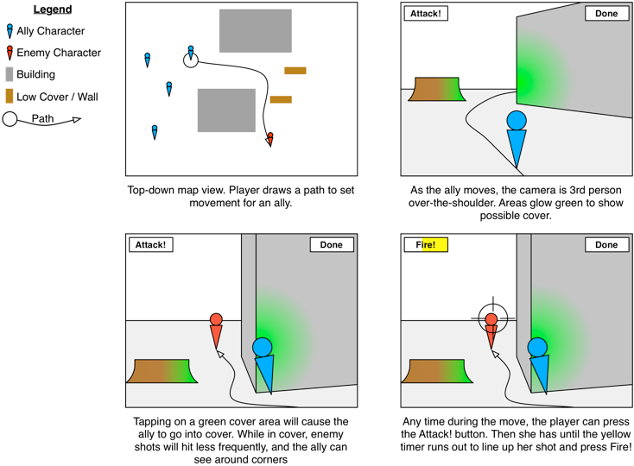
Example Paper Prototype
Initial Game Concept
  Start by making simple mockups of the digital game screens

Slide 11
Example Paper Prototype
Elements that can be tested with the paper prototype
  Map Layouts / Level Design
    What kind of maps will work well for this game?
    Which layouts make the game easier or more difficult for the player?
  Artificial Intelligence
    As the Game Master (GM), the designer will play the role of the AI
    Acting as the computer player during playtests, the designer can learn several things
      How much information about the player's troops the AI should have
      The best goals (and ranking of goals) for the AI
      Good AI moves and attack types
    From the experience of pretending to be the AI during playtests, a designer can learn how the AI should be designed
    Remember, the AI should be designed not to defeat the player, but instead to be fun for the player to defeat!

Slide 12
Example Paper Prototype
Elements that can be tested with the paper prototype
  Weapon Designs
    Several aspects of weapon design can be tested
      Chances of each shot hitting (Accuracy)
      Amount of damage per shot
      Effective range
      Balance vs. other weapons
      And several others similar aspects
  Finding the Fun
    Some of the fun of the digital game will be due to graphics, movement, and touch-based interaction
    But, the fun of the core mechanic should come from tactically outsmarting the enemies
      This can absolutely happen in the paper prototype

Slide 13
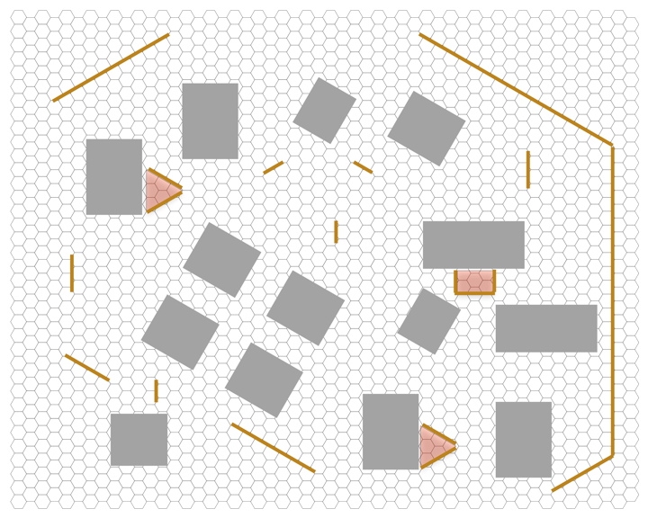
Constructing the Prototype
Start this game by building a Player Map
  1/2" Hex graph paper
  Gray = buildings / Brown = low walls / Red = capture points

Slide 14
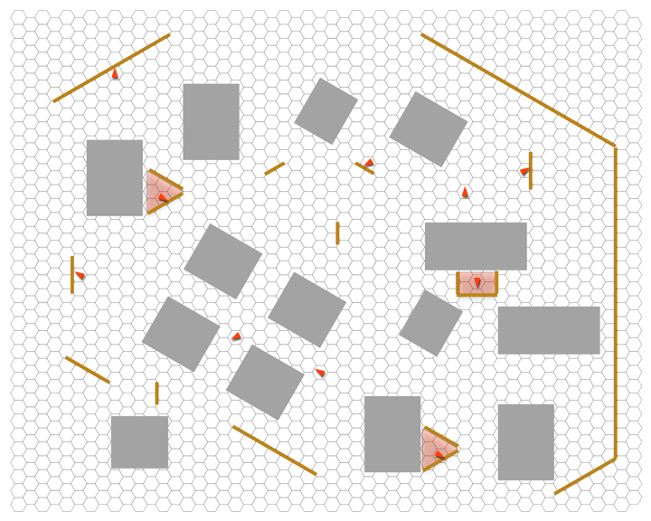
Constructing the Prototype
Then make a GM (Game Master) Map
  1/4" Hex graph paper
  Little red triangles = Enemy units

Slide 15
Constructing the Prototype
Then make a GM (Game Master) Map
  1/4" Hex graph paper
  Little red triangles = Enemy units
  When placing enemy units, remember
    You are designing for player fun and (eventual) success
    Players want to be able to sneak up on enemies
    Leave blind spots in your patrols

Slide 16
Constructing the Prototype: Rules
Objective
  The player's objective is to capture all three control points
Required Equipment
  1/2" Hex-grid map showing buildings, walls, & control points
  1/4" Hex-grid map for the GM showing enemy unit locations
  Several six-sided dice
  Unit markers that can fit within a single hex and have an obvious facing direction
    Units should also be colored and numbered (e.g. Red-5)
    Player units are blue / Enemy units are red
      Colors don't matter, but avoid red/green for colorblindness
  A sheet of paper to track the health of each unit
  A sheet of paper for playtest notes

Slide 17
Constructing the Prototype: Rules
Setup
  The player is given four units
    In the first playtest, all units will have the same weapons and abilities
  Player may select any hex on the edge of the map as her start position and place one unit there
    All other player units must be placed in adjacent hexes

Slide 18
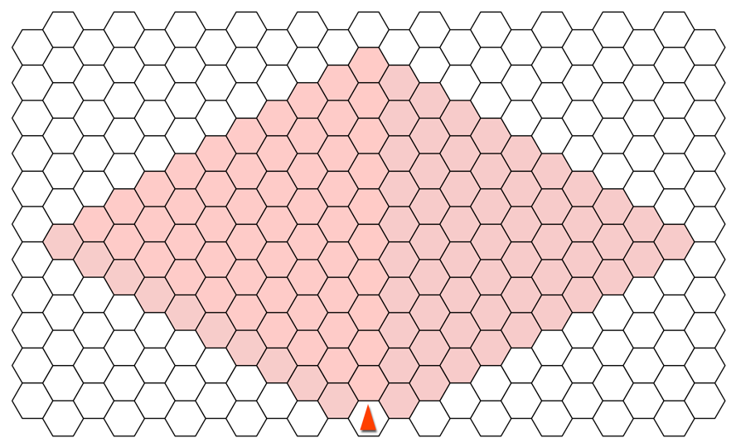
Constructing the Prototype: Rules
Visibility
  A unit can see a distance of 10 spaces in an arc in front of it
    Units can also share visibility information with nearby units
    Buildings block visibility
    Visibility is shown in the red hexes below

Slide 19
Constructing the Prototype: Rules
Visibility
  A unit can see a distance of 10 spaces in an arc in front of it
    Units can also share visibility information with nearby units
    Buildings block visibility
    Visibility is shown in the red hexes below
  The GM is responsible for visibility calculations
    As soon as an enemy unit is visible to the player, the GM should place it on the player map
    When the enemy unit is not longer visible, the GM should remove it

Slide 20
Constructing the Prototype: Rules
Movement
  On each of the player's turns, she has 4 Action Points (AP)
  Spending 1 AP allows her to move one player unit
    A unit can move 8 hexes on its first action per turn
    If more AP are used on the same unit this turn, it moves 2 less / AP
      2nd AP = 6 hexes, 3rd AP = 4 hexes, 4th AP = 2 hexes
  Player units can move in any direction
  While moving, the unit has visibility of 10 in all directions
    Facing only matters when units are stationary
  Once during an action, the player unit can fire her weapon

Slide 21
Constructing the Prototype: Rules
Weapons and Firing
  Each unit carries one weapon
    Give all units Pistols in the initial playtest
  A unit can shoot at any other unit that is visible to it
  Process:
    Calculate the odds of hitting based on the range to the enemy and the table on the next slide
    Roll 1d6 for each of the shots fired (a Pistol has 3 shots)
    Compare each die roll with the to-hit value for that range
    The enemy unit would take 2 points of damage for each shot that hit

Slide 22
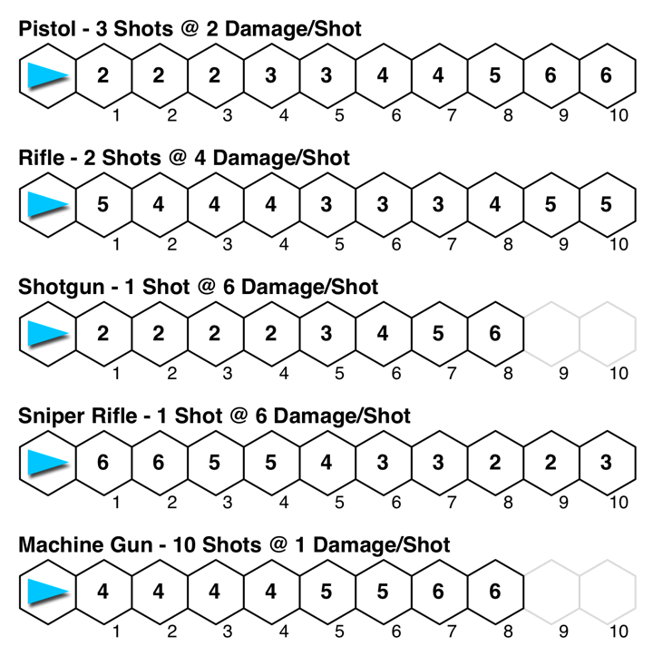
Constructing the Prototype: Rules

Slide 23
Constructing the Prototype: Rules
Weapons and Firing
  Each unit carries one weapon
    Give all units Pistols in the initial playtest
  A unit can shoot at any other unit that is visible to it
  Process:
    Calculate the odds of hitting based on the range to the enemy and the table on the next slide
    Roll 1d6 for each of the shots fired (a Pistol has 3 shots)
    Compare each die roll with the to-hit value for that range
    The enemy unit would take 2 points of damage for each shot that hit
  Counterattacks!
    If the targeted unit is survives the attack:
      It immediately turns to face its attacker and shoots back

Slide 24
Constructing the Prototype: Rules
Cover
  If a unit is in a hex that is adjacent to either a low wall or the corner of a building, it is considered in cover
  While in cover, the damage taken by a unit is halved (rounded down)
    If a unit is shot, and the damage would have totaled 7 points
    The damage is halved and rounded down to 3 if the unit is in cover

Slide 25
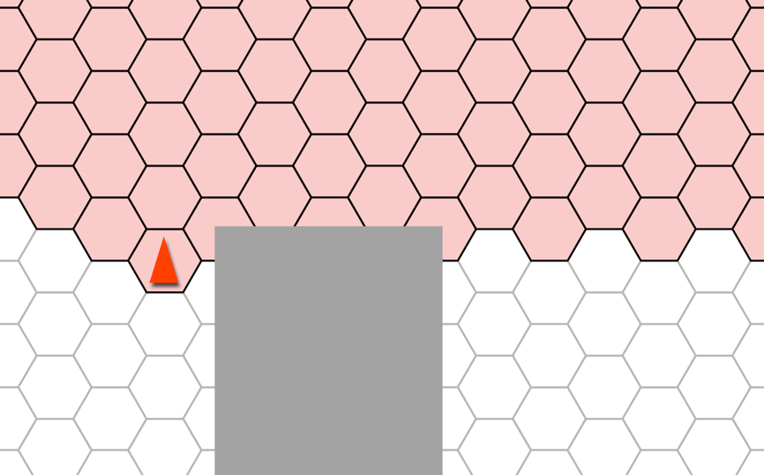
Constructing the Prototype: Rules
Corner Cover and Visibility
  If a unit is in cover next to the corner of a building the unit is treated as having visibility around both sides of the corner
    Simulates peering around the corner

Slide 26
Constructing the Prototype: Rules
Health
  Each unit starts with 6 points of health
  If a unit's health drops to 0, that unit is knocked out
    Knocked out units cannot act, but are immune to damage
Health Pack
  Each unit carries 1 health pack
  A health pack can be used
    In place of the attack during an action
    On the active unit or on a unit in an adjacent hex
  A health pack replaces 4 points of health
    This can revive a knocked out unit
    Health cannot be raised above 6

Slide 27
Constructing the Prototype: Rules
Interception Fire
  Stationary units can sometimes fire on the active unit!
  This Interception Attack happens when:
    The active unit enters the stationary unit's visibility and firing range
    The active unit exits the stationary unit's visibility (or firing range, if that is shorter)
    The active unit ends its action within the stationary unit's visibility
  Once the stationary unit has fired on the active unit, the stationary unit will turn its facing to follow the active unit
  In an Interception Attack half of the normal shots are fired (rounded up)
  If both the active unit and the stationary unit wish to fire at the same time, the active unit always shoots first

Slide 28
Constructing the Prototype: Rules
Capturing Control Points
  The active unit may claim a Control Point if:
    It unit ends its action in a shaded Control Point area
    And there are no conscious enemies within the Control Point
  Enemy units can recapture the Control Point using the same rules
  If the player captures all three Control Points, she wins!

Slide 29
Constructing the Prototype: GM Strategy
Remember, your goal is for the player to have fun
  Not too easy, but also not too hard
Things to consider
  The GM has more units than the player, so GM units shouldn't be moved until they are aware of the player
    Either the unit sees a player unit or a nearby GM unit sees one
  Once the player takes a Control Point, all GM units are aware it has been taken
    GM units could start moving towards the Control Point to recapture it
  Remember to track not only which GM units the player can see but also which player units the GM units can see
    GM units should only act on their local information
  Take notes about which strategies work well to provide a fun, challenging experience for the player

Slide 30
Playtest Questions
When you run the playtest, think about these questions:
  Did the map layout work? Why do you think it did or didn't?
  Are the weapons balanced? Is one over- or under-powered?
    More on weapon balancing in Chapter 11
  Is 6 points the right amount of initial health?
    Is 4 points the right amount to be healed?
  Is your GM strategy sound?
  Is the player having fun?
Be sure to write down all of these answers!
More on testing in Chapter 10, "Game Testing"

Slide 31
Best Uses of Paper Prototyping
Understanding player movement through space
  Players tend to choose similar paths through space
  Understanding player flow through space will help you in all aspects of level design
Balancing simple systems
  These weapons are all based on three simple variables
    Accuracy over distance / Number of shots / Damage per shot
  Balancing each weapon against the others can be complex
    Shotgun: 6 damage per shot, will kill an enemy with one shot
      At a range of 1 to 4, any roll other than 1 will hit
      But if that shot misses, the enemy will take no damage at all
    Machine Gun: 1 damage per shot (6 shots must hit to kill a enemy)
      At a range of 1 to 4, any roll above 3 will hit
      With 10 shots, it is much more likely that you will get close to the average damage of the gun at that distance (5 points)

Slide 32
Best Uses of Paper Prototyping
Graphical User Interface (GUI)
  Print several mock-ups of a GUI (i.e., buttons, menus, input fields)
  Ask testers which buttons they would press to accomplish a certain task (e.g., pausing the game, picking a character).
Trying wild ideas
  Easy to try a crazy rule every once in a while to see how it changes gameplay
    What if interception fire happened once for every step taken by a moving player?
    What if attackers got a damage or to-hit bonus for firing on a target that was unaware of them (that is, that couldn't see them)?
  These are easy questions to answer with a paper prototype

Slide 33
Poor Uses of Paper Prototyping
Tracking lots of information
  Several things in the prototype could have been handled better by a computer
    Visibility calculations
    Tracking health
    Counting how many spaces an attacker is from a target
    etc.
  Paper prototype should focus on simple systems in a game
    Level layout
    The general feel of each weapon
      The "risky" shotgun and the "reliable" machine gun
  Fine-tune this information later with the digital prototype

Slide 34
Poor Uses of Paper Prototyping
Game rhythm for fast or slow games
  Paper prototypes can givea false impression of game rhythm if the game will be played much more quickly or more slowly than the paper prototype
    If this were an action game, the player would have a lot less time for thought and strategizing in the real game than the prototype
Physical interface
  Paper prototypes work well for GUIs but have very little to tell us about physical interfaces
    Gamepad controllers / Touchscreens / Keyboard and Mouse / etc.
  Only a digital prototype can test the actual physical interface that will be used by the player

Slide 35
Chapter 9 – Summary
Paper prototypes are quick and easy to implement
They are great testbeds for game ideas
They also teach you not to be discouraged if your design isn't all that great
  Just make another prototype with a different idea!
Next Chapter:
  One of the most important aspects of game design is testing
  The next chapter covers several different types of game testing and shows you how to run them

